Slide 1
SCADA Standards Project (Update)
Operators Workshop
October 2022

Slide 2
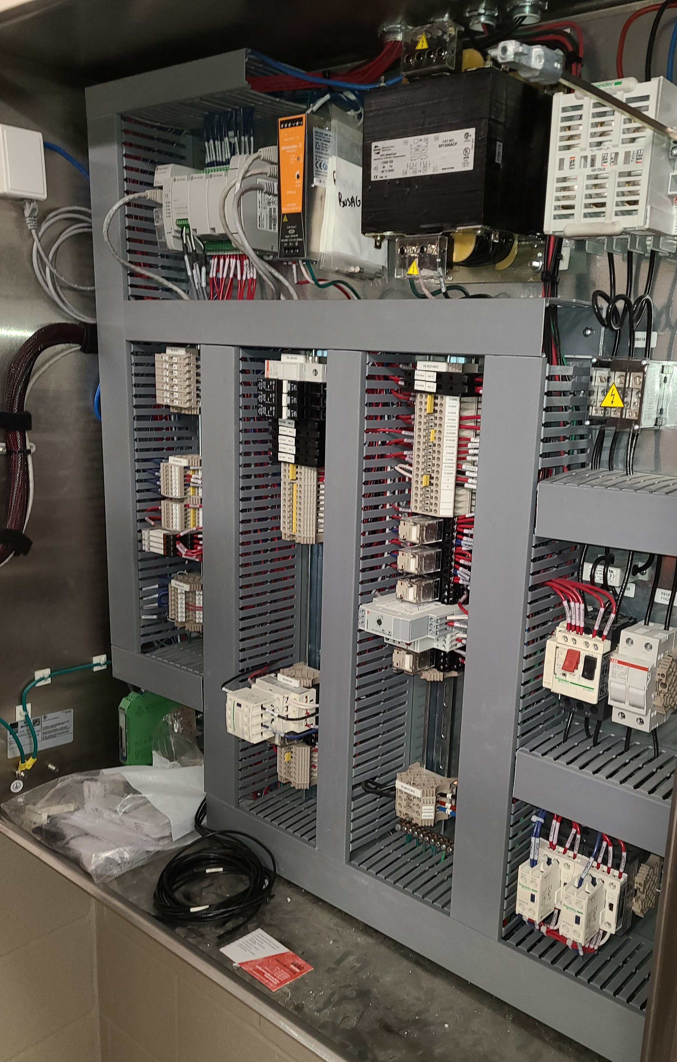
Agenda
SCADA Master Plan Overview
Current State
Desired State
Engagement
Capital Plan
SCADA Standards
Pilot Projects
Questions/Discussions

Slide 3
SCADA Master Plan Overview
In response to RFP, four proposals were received.
Eramosa Engineering was selected.
Scope of work included:
Development of network/communications architecture
Field observation of SCADA sand security/cybersecurity
Documentation of Current State
Analysis of Current State
Development of Desired State

Slide 4
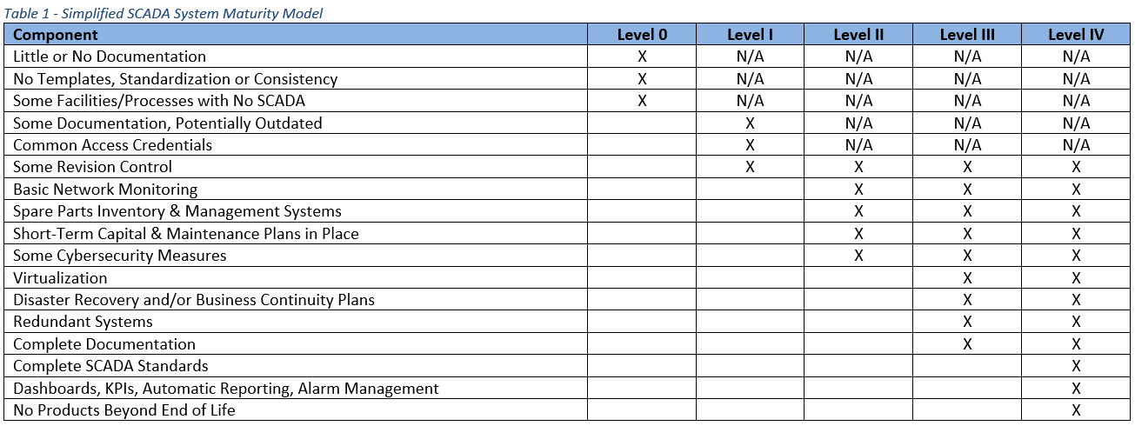
Current State

Slide 5
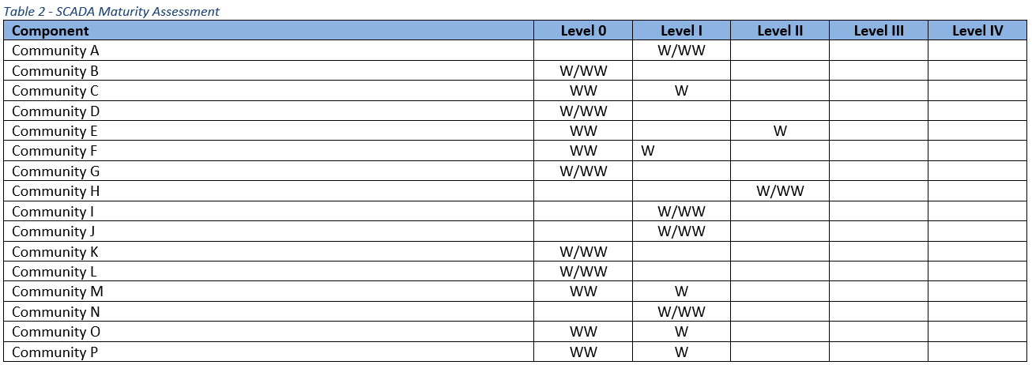
Current State

Slide 6
SCADA System Components

Slide 7
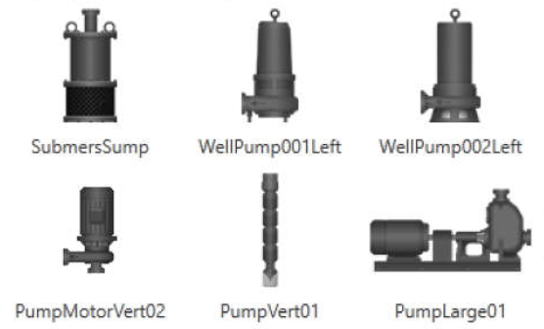
Desired State
Components addressed by the standards:
RTU programming
RTU hardware
HMI programming
Tagging/coding
Alarming
Process control narrative
FAT/SAT
Process & Instrumentation Diagrams
Network hardware

Slide 8
Engagement
Met with AFNWA staff to review technical options
Conducted workshops to review with staff and operators
Consulted on technical aspects including
Panel layout
Tagging and coding for programming
Submittals from designers and integrators
Alarming
Network and cybersecurity

Slide 9
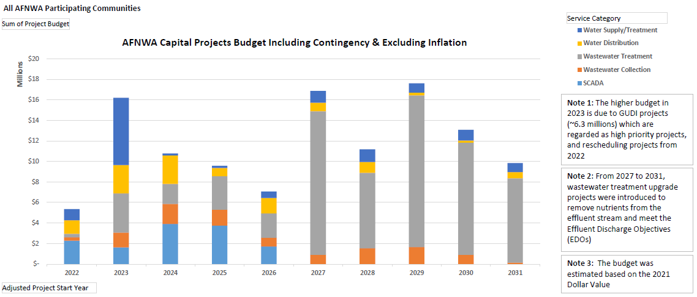
Capital Plan

Slide 10
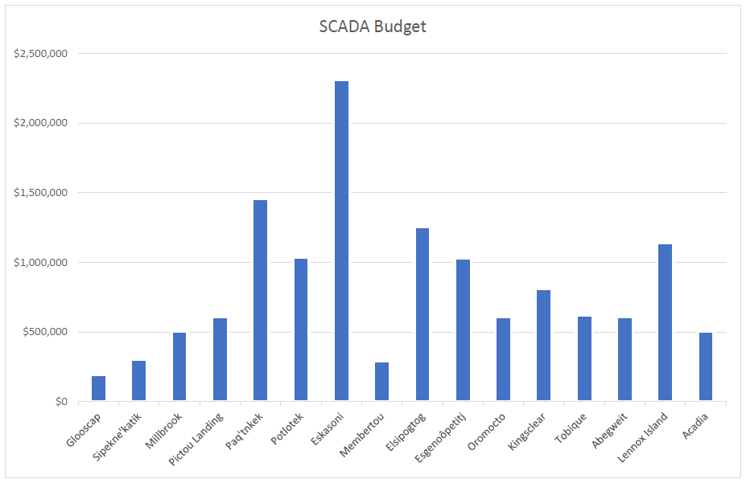

Slide 11
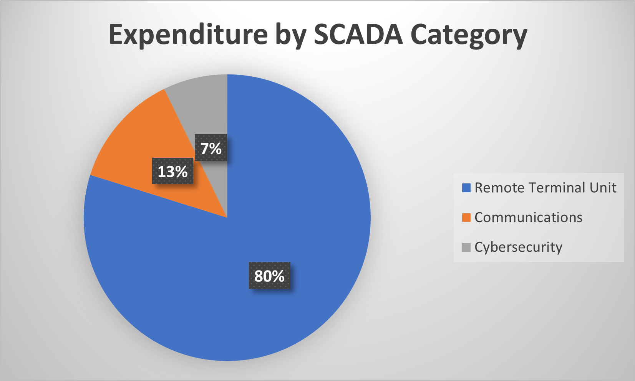
SCADA Capital Plan
RTU (80%)
Communities: $9.7 M
Global: $0.9 M
Total RTU: $10.6 M
Communications (13%)
Communities: $0.89 M
Global: $0.83 M
Total Comms: $1.72 M
Cybersecurity (7%)
Communities: $0.40 M
Global: $0.56 M
Total Cyber: $0.96 M

Slide 12
SCADA Standards
Components addressed by the standards include:
RTU programming
RTU hardware
HMI programming
Tagging/coding
Alarming
Process control narrative
Factory Acceptance Testing/Site Acceptance Testing
Process & Instrumentation Diagrams
Network hardware

Slide 13
Transition Projects
What about ongoing projects that are in the design stage already?
Design documents were reviewed and comments provided by staff and Eramosa.
Changes were requested to adhere to hardware and software standards, if possible.
Most projects were able to make this adjustment.
It was too late for some projects.

Slide 14
Pilot Projects
Scope of work included pilot projects.
Factors:
Community readiness
System condition
Two pilot projects were identified:
Pictou Landing (connection of new well)
Lennox Island (level control for lift stations)

Slide 15
Save the Dates
In-person workshop to present the SCADA Standards
Dates: November 14 & 15
Location: Millbrook Legends
Accommodations: Millbrook Hampton

Slide 16
Wela’lin! Woliwon!
Questions?
www.afnwa.ca

