Slide 1

Update on
Regulatory Compliance Program for Wastewater
Operator Workshop, Moncton, NB
October 12, 2022
Carl Yates, interim CEO

Slide 2
Outline
Overview of Wastewater Systems Effluent Regulations (WSER)
Monitoring
Sampling
Reporting
Enforcement
Proposed Amendments

Slide 3
Purpose of the Regulations
The WSER came into force on June 29, 2012 and were made under the Fisheries Act
Goal is to reduce threats to the environment and human health
The WSER sets national baseline effluent quality standards achievable through a secondary level of wastewater treatment

Slide 4
WSER Application – Who is Regulated
Applicable to wastewater systems that collects, or are designed to collect, an average volume of 100 cubic metres/day (100 000 Litres) or more of influent;
AND
Discharge effluent to water frequented by fish, or any place that can reach such water, whether it is treated or not.
*Step one: Identifying your system with ECCC*
Wastewater effluent discharge from small systems and northern systems are subject to the Fisheries Act general prohibition

Slide 5
Types of Wastewater Systems Under Regulations
Intermittent wastewater system (lagoons)
  Hydraulic retention time (HRT) ≥ 90 days
  Maximum of 4 discharge periods/year
    Discharge periods must be separated by at least 7 days of no discharge
Continuous wastewater system
  Hydraulic retention time (HRT) of ≥ 5 days (lagoon)
  Mechanized treatment plants
  Raw sewage outfalls

Slide 6
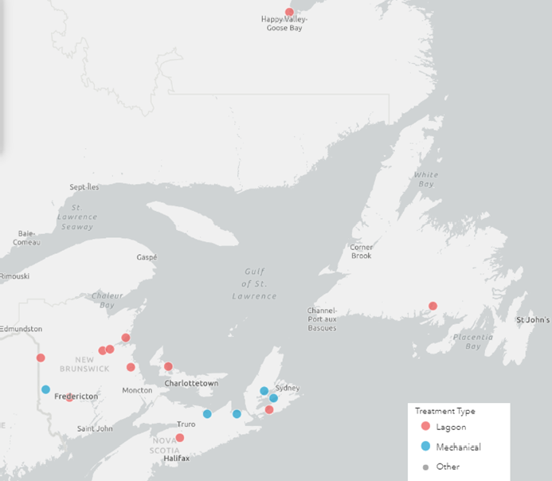
First Nation Wastewater Systems

Slide 7
Deposits to Fish Bearing Water
Subsection 36(3) of the Fisheries Act Pollution Prevention Provisions prohibits the deposit of all deleterious substances:
  Into water frequented by fish, or
  To any place, under any condition, where it may enter water frequented by fish
The WSER were developed under the Fisheries Act to authorize the deposit of effluent from the final discharge point under certain conditions
If your system is not subject to the WSER, the deposit of effluent is subject to the Fisheries Act.

Slide 8
Point of Entry
Point of entry, in relation to the final discharge point of a wastewater system, means:
a) the point where effluent is deposited in water frequented by fish via the final discharge point; or
b) any point where the effluent enters that water from the place where it was deposited via the final discharge point.

Slide 9
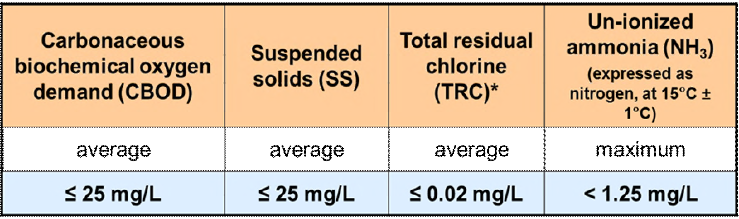
Authorization to Deposit
To comply with WSER the effluent must meet specific conditions during discharge:
  Limits on the concentrations of certain pollutants (CBOD, suspended
solids, total residual chlorine and un-ionized ammonia)
  Effluent deposited cannot be acutely lethal to fish (i.e. poisonous)
  Effluent quality standards came into effect January 1, 2015
*TRC standard for systems < 5000 m³/day is in effect January 1, 2021
*Un-ionized ammonia (NH3) reporting requirements ended June 30, 2014, but the standard for NH3 must still be met

Slide 10
Monitoring and Sampling Requirements
Monitoring requirements include:
  Daily volume of influent or effluent
  Carbonaceous Biological Oxygen Demand (CBOD) and Suspended Solids (SS)
  Acute lethality monitoring for systems ➔ only required for systems depositing > 2,500 m³/d
  Un-ionized Ammonia (NH₃) monitoring requirements ended June 30, 2014
  Must meet the average Total Residual Chlorine (TRC)
* came into force January 1, 2021
Accredited laboratory required to conduct tests

Slide 11
Transitional and Temporary Authorizarions
The Regulations provide a mechanism to apply for authorizations for systems to deposit effluent that does not meet the quality standards at the final discharge point
Transitional Authorization | Allowed for extended compliance timelines for systems not designed to meet the standards; to provide time to plan and finance wastewater system upgrades
Temporary Bypass Authorization | Allows for a temporary exceedance of effluent quality limits to undertake maintenance, repairs and upgrades to wastewater treatment plants; to ensure the longevity and proper functioning of wastewater infrastructure
Temporary Authorization to Deposit Un-ionized Ammonia | Issued for systems discharging acutely lethal effluent due to un-ionized ammonia, but otherwise compliant with TSS/CBOD effluent quality standards

Slide 12
Unauthorized Wastewater Discharges
Combined Sewer Overflows (CSOs)
Planned Discharges
Wastewater Spills
Overflows in combined sewer systems that collect stormwater and domestic wastewater in the same pipe
Occur due to heavy rainfall or snowmelt where volume exceeds system capacity
Releases from any overflow point of a wastewater collection system, other than final discharge point
Scheduled to conduct construction, repair or maintenance work (e.g. Montreal 2015)
Spills in the wastewater collection systems
Resulted from system failures, negligence, or unforeseen circumstances
an inspector must be notified without delay of a deposit (or the serious and imminent danger of such an occurrence) that results in, or may reasonably be expected to result in, detriment to fish, fish habitat or human use of fish
Section 38 of the Fisheries Act requires that the owner/operator notify an inspector and take all reasonable measures to prevent or mitigate any adverse effects.
a written report must be sent to an inspector or a fishery officer as soon as feasible after the occurrence or after learning of the danger of the occurrence

Slide 13
Effluent Monitoring and Reporting
Requirements vary depending on the SIZE of wastewater system
Annual Average Daily Volume(m³) | Type of Sample | Minimum Sampling Frequency
< 2500* | Grab or composite | Monthly but at least 10 days after any other sample
>2500 and < 17500 | Composite | Every 2 weeks but at least 7 days after any other sample
> 17500 and < 50000 | Composite | Weekly but at least 5 days after any other sample
> 50000 | Composite | 3 days a week but at least 1 day after any other sample

Slide 14
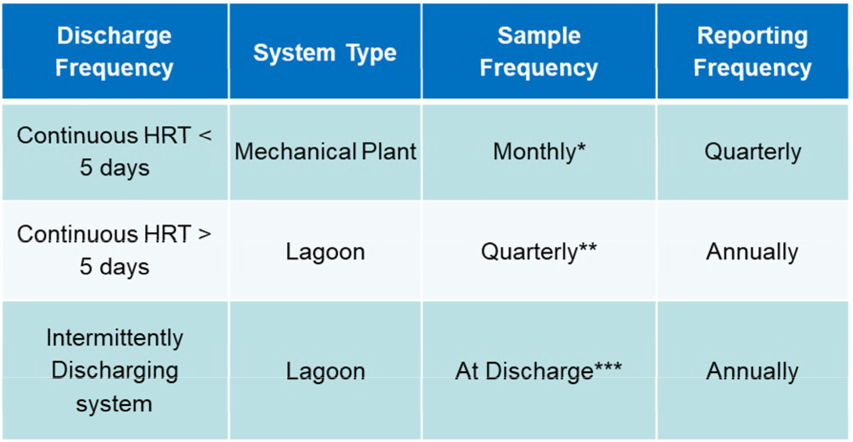
Effluent Monitoring and Reporting
Requirements vary depending on the TYPE of wastewater system
*Sample at least 10 days after any other sample
**Sample at least 60 days after any other sample
***Sample every two weeks but at least seven days after any other sample if the discharge period is greater than 30 days

Slide 15
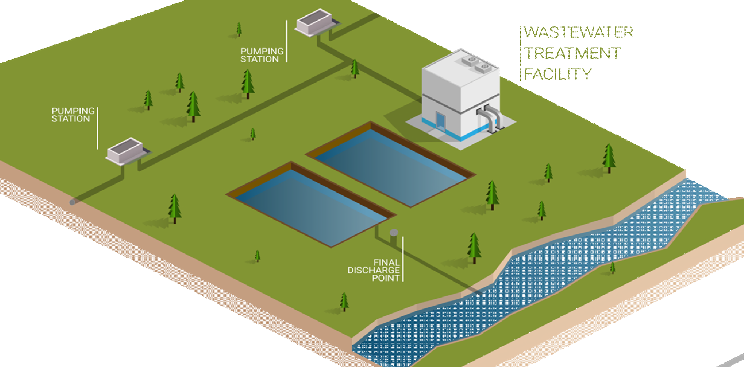
Sampling – Final Discharge Point

Slide 16
Reporting Requirements
Identification report
  All systems in operation should have submitted an ID report with all required information including if the influent flowrate is equal or greater than 100m³ daily and discharges to water frequented by fish; or
  New systems within 45 days after system comes into operation
Monitoring reports
Due 45 days after end of calendar year or quarter, depending on type of system
Calendar year (February 14)
  Intermittent systems ≤ 17500 m³/d
  Continuous systems with HRT ≥ 5 days and ≤ 2500 m³/d
A quarter
  Any other system
Reports submitted electronically using the Effluent Regulatory Reporting Information System (ERRIS) or in a paper copy sent to ECCC

Slide 17
What is Swim and Erris?
SWIM is the acronym for Single Window Information Manager
Serves as the “front door” to many reporting programs and provides a way of connecting individuals to these programs, including ERRIS
SWIM has tools to help manage information for organizations, facilities, and individuals
ERRIS is the acronym Effluent Regulatory Reporting Information System

Slide 18
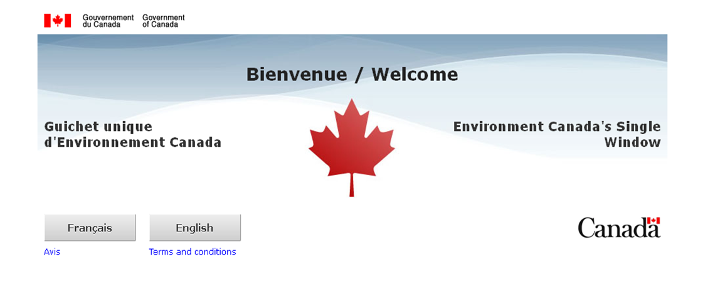
Swim Link
HTTPS://EC.SS.EC.GC.CA
YouTube:
https://youtu.be/xSlTL-O5Qcs?list=PLF90V7foF0CemVXJIRj4IlNIgIoRguRA7

Slide 19
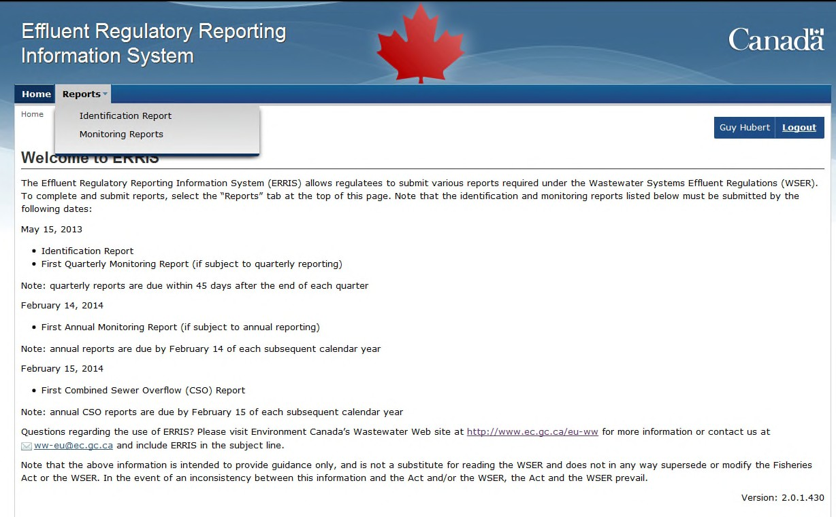
Effluent Monitoring and Reporting
Reporting done through on-line system ERRISA

Slide 20


Reporting Requirements
Annual Reporting Due February 14

Slide 21
Reporting Requirements
Quarterly Reporting Due January 1 to March 31 – May 15
April 1 to June 30 - August 14
July 1 to September 30 - November 14
October 1 to December 31 - February 14

Slide 22
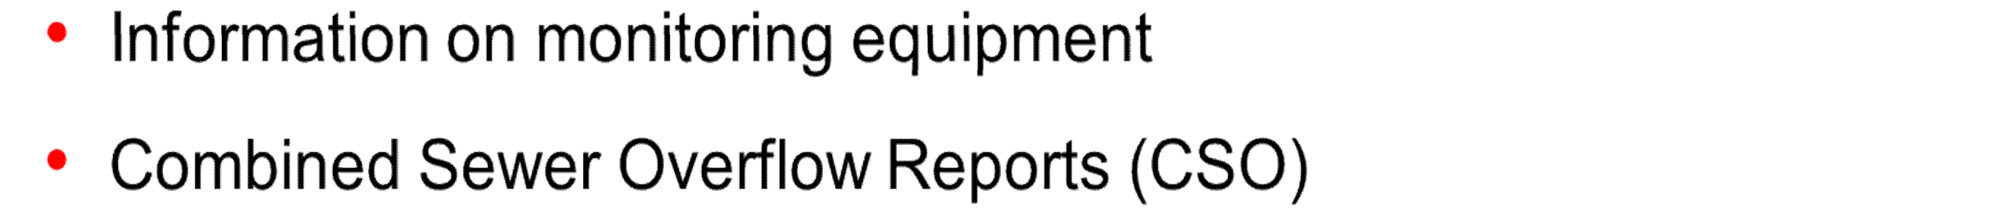
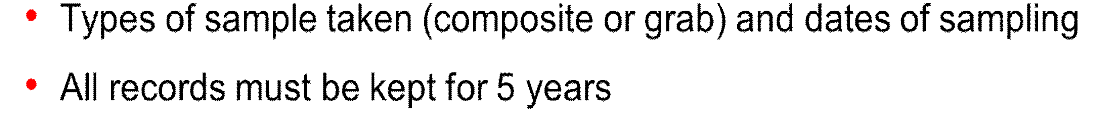
Record-Keeping Requirements

Slide 23
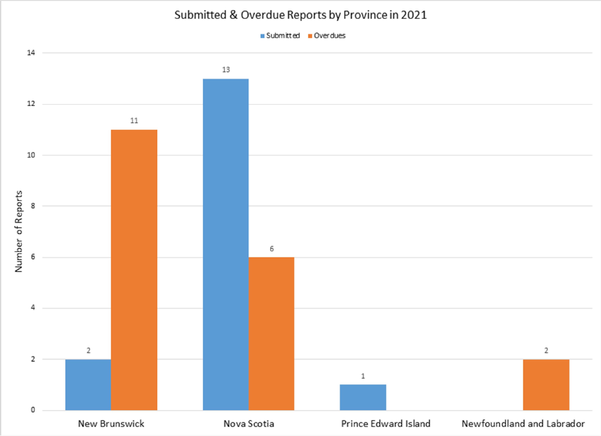
Atlantic Canada First Nations

Slide 24
Compliance Promotion
The Compliance Promotion objective related to WSER in Indigenous communities:
Improve awareness and understanding of regulations in Indigenous communities
Decrease administrative non-compliance by supporting owners/operators of wastewater systems in identifying their system in ERRIS and submitting reports
Building capacity within communities and their supporting agencies to maintain ongoing sampling and reporting requirements
Approach is to build and maintain relationships with First Nations and their supporting agencies to determine best opportunities to promote compliance through:
Participation in and presentations at meetings, conferences and tradeshows
Site visits to communities / workshops
Provide WSER training and support via phone, email and/or letter campaigns
Compliance Promotion Officers also coordinate with regional Enforcement Officers and share information to align their approach.
Compliance Promotion - Atlantic
M.T. Grant
Telephone: 902-401-4219
Email: mt.grant@ec.gc.ca

Slide 25
Now What?
Regulations have been in force for over 10 years
  ID reports should have been submitted by now
  Monitoring reports should be submitted as per your reporting schedule
Consequences of not complying with the Regulations
Enforcement Officers will be doing inspections
The Compliance and Enforcement Policy dictates the responses to violations but could vary from a warning letter to prosecution (the focus is always to get the systems into compliance)

Slide 26

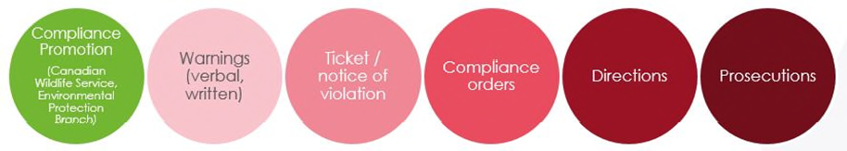
Enforcement
Designated under the Fisheries Act to enforce the law
Compliance with these provisions is mandatory and Enforcement Officers work to apply the law in a manner that is fair, predictable and consistent in accordance with the Compliance and Enforcement Policy
Before deciding on how to respond to violations, Officers will consider factors such as the nature of the violation, how to best achieve the desired results and consistency in enforcement
The goal of ECCC’s Enforcement Branch activities with respect to the Regulations is to work with communities to bring their systems into compliance with the regulatory requirements within the shortest time possible through the reasonable exercise of discretion and using a range of available enforcement responses when such responses are warranted.

Slide 27
Objective of Temporary Bypass Authorizations
Temporary bypass authorizations allow communities to temporarily exceed effluent quality limits when undertaking regular maintenance, repairs and upgrades to wastewater treatment plants
Types of work include: cleaning filters, repairing lagoon liners, replacing parts that have reached end of service life such as pumps or valves
Bypasses vary widely in terms of duration (few hours to a few weeks) and level of treatment of the effluent (from no treatment to secondary)

Slide 28
Temporary Bypass Authorizations
Temporary bypass authorizations may be issued by the authorization officer if:
  Release occurs at the wastewater system’s final discharge point
  Required for construction, maintenance or repairs
  Designed to minimize volume of effluent deposited and concentration of deleterious substances
  Made at least 45 days in advance
Communities must mitigate environment impacts to whatever extent is possible
ECCC may refuse to issue these authorizations if there is reasonable grounds to believe that the authorization would result in adverse effects on fish, fish habitat or the use by man of fish that cannot be mitigated
10-20 requests assessed each year; some requests are only submitted as a precaution, many systems are able to maintain some level of treatment while performing the required work

Slide 29
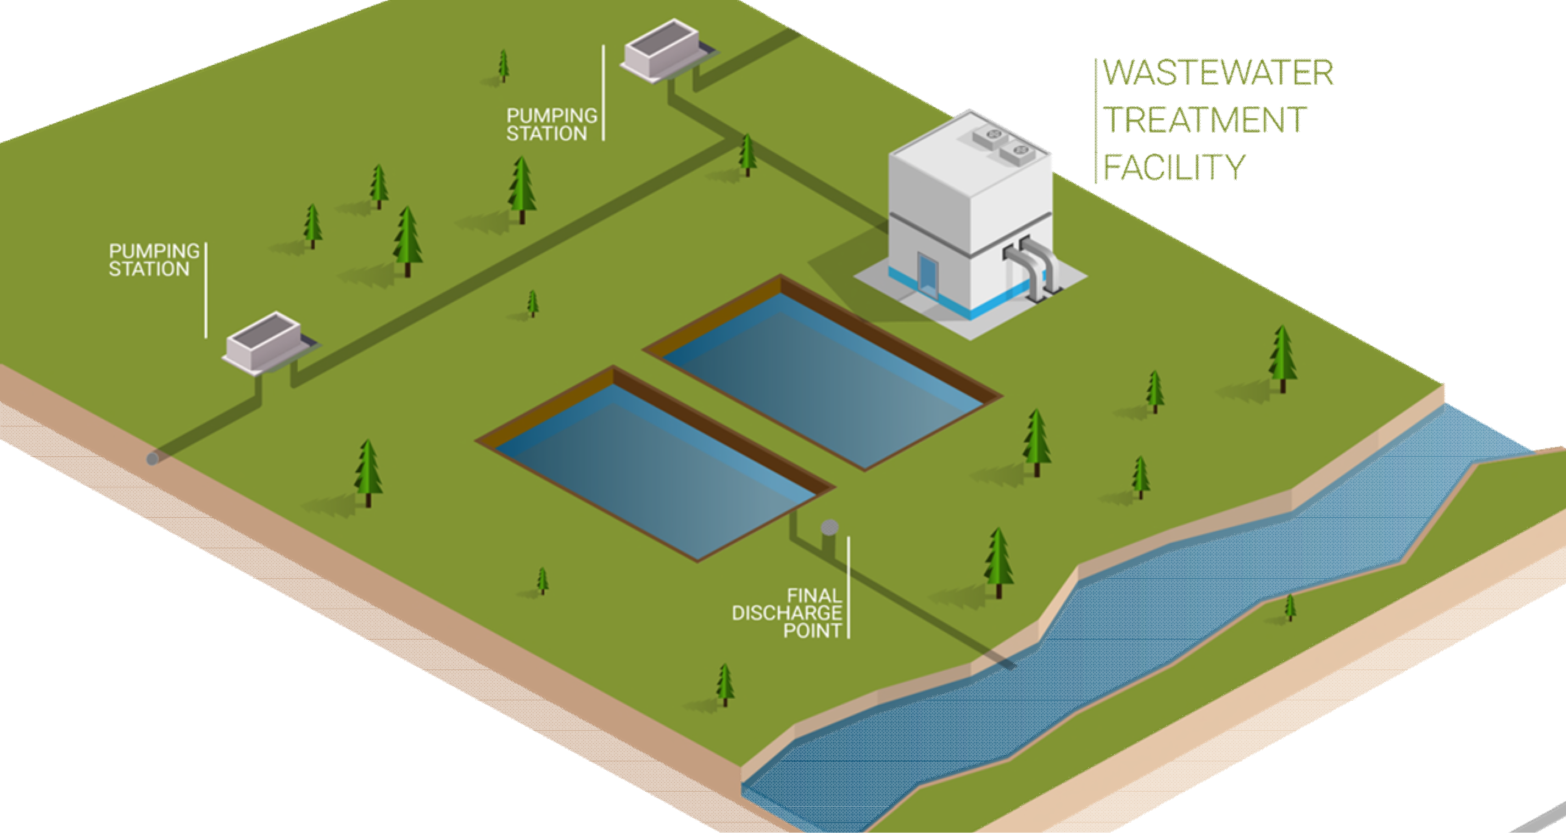
Final Discharge Point

Slide 30
Issue
Communities need to perform maintenance and repairs in their collection systems which can result in unavoidable releases of undertreated wastewater from overflow points
  Types of work include: repairing or replacing aging sewer pipes, critical maintenance to pumping stations, de-clogging sewer pipes
Range from very small, short duration events, to larger releases lasting a few days; generally resulting in releases of untreated wastewater
  Releases occur for health and safety of workers, to prevent breakages, or sewage backups
Currently not authorized under the WSER and are subject to the pollution prevention provisions of the Fisheries Act
  Likely that ECCC is not notified of all events (10-20 releases are reported yearly on average)
  Planned discharges from sewer systems are allowed under some provincial regimes
  Many of the actions that ECCC can take, will occur after a release has already occurred
Concerns have been raised over absence of regulatory mechanism to authorize under federal regime, provide sufficient oversight, and ensure appropriate notification and engagement to impacted communities

Slide 31
Proposed Amendments on Planned Releases
Expand the scope of current provisions to allow temporary bypass authorizations for all planned releases of wastewater for maintenance, repairs, and/or upgrades
Set clear conditions to ensure transparency and reduce the environmental and social impacts of these planned releases, such as :
  Notification provisions
  Mitigation measures
  Enhanced monitoring requirements
  Additional reporting requirements
When amending the regulations, ECCC will consider best practices and available solutions to avoid planned releases, reduce their frequency and duration, mitigate their effects and eliminate them in the longer-term

Slide 32
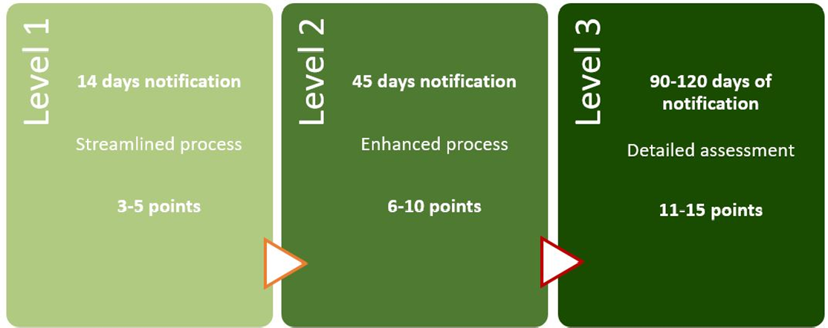
Proposed Tiered Approach
*ECCC may also engage Indigenous communities

Slide 33
Proposed Amendments
Propose to use a point based scheme for all temporary bypasses to assess the potential level of risk of a release
Points are assigned depending on a number of criteria
Criteria | 1 point | 3 points | 5 points
Rate of flow (volume/duration) | < 250 m³/hour | 250 – 2,500 m³/hour | > 2,500 m³/hour
Level of treatment | Greater than primary treatment | Primary treatment | No treatment
Receiving environment | Open marine waters / Larger rivers | Lake/Enclosed bay/Estuary | Small rivers/shellfish harvesting areas

Slide 34
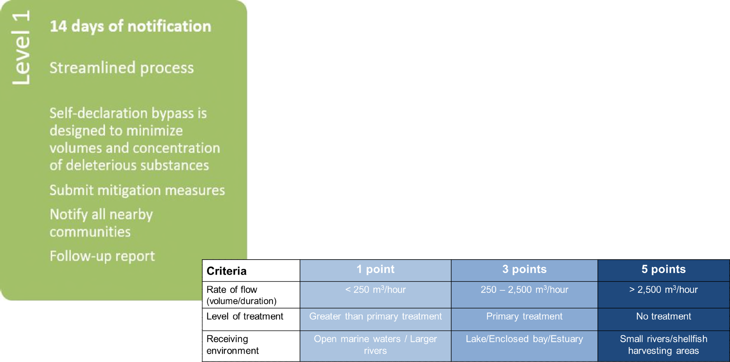
Level 1 (3 – 5 Points)

Slide 35
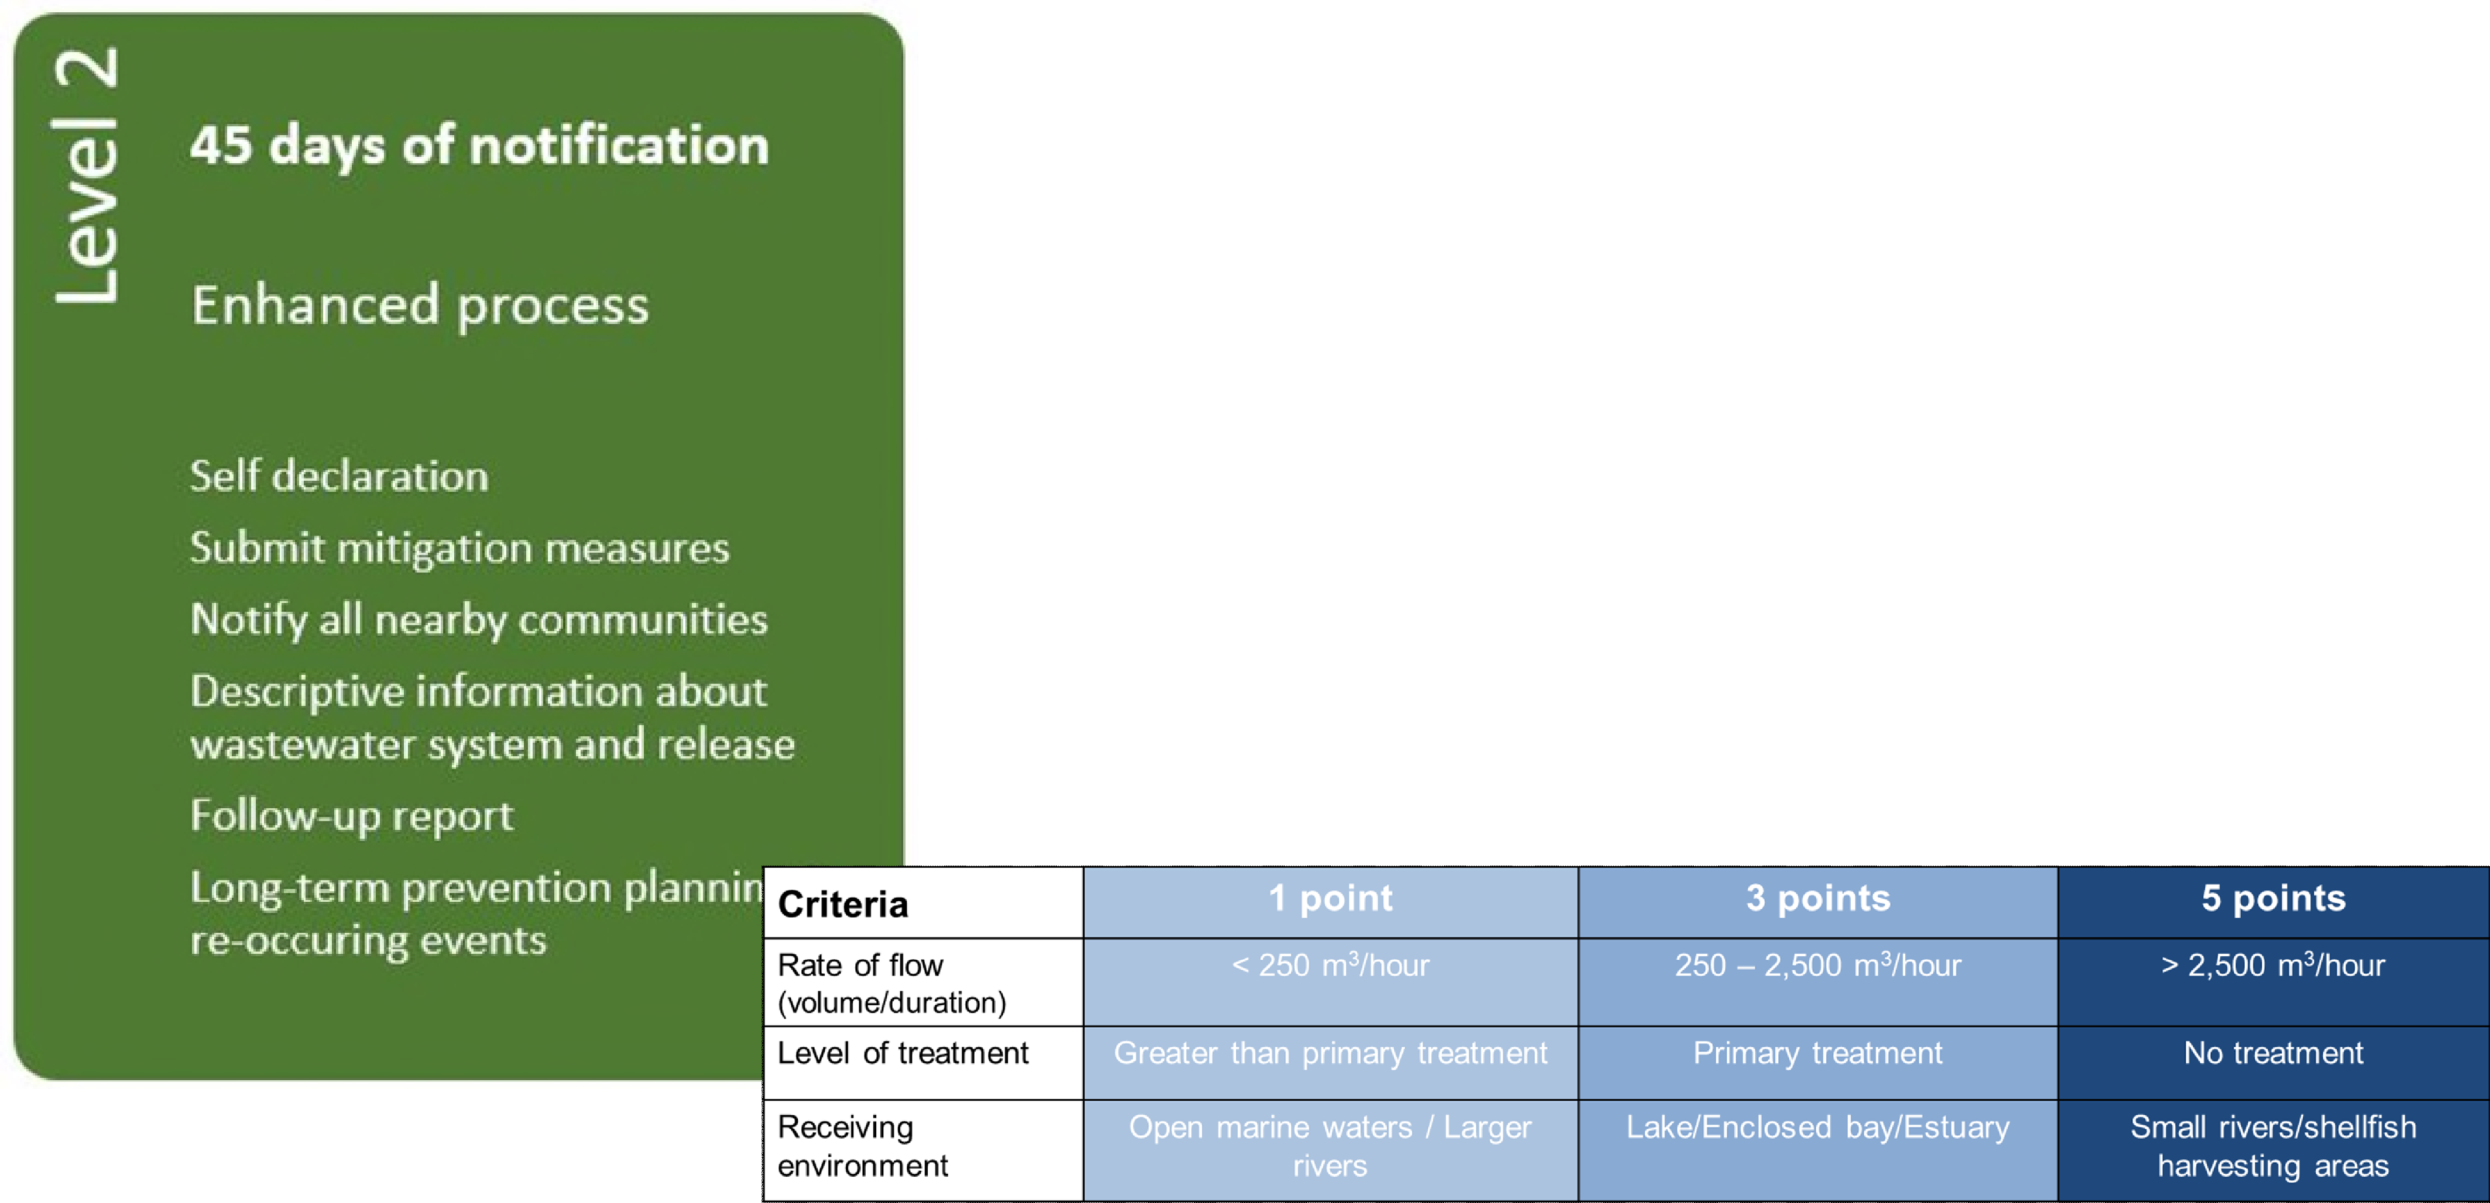
Level 2 (6 – 10 Points)

Slide 36
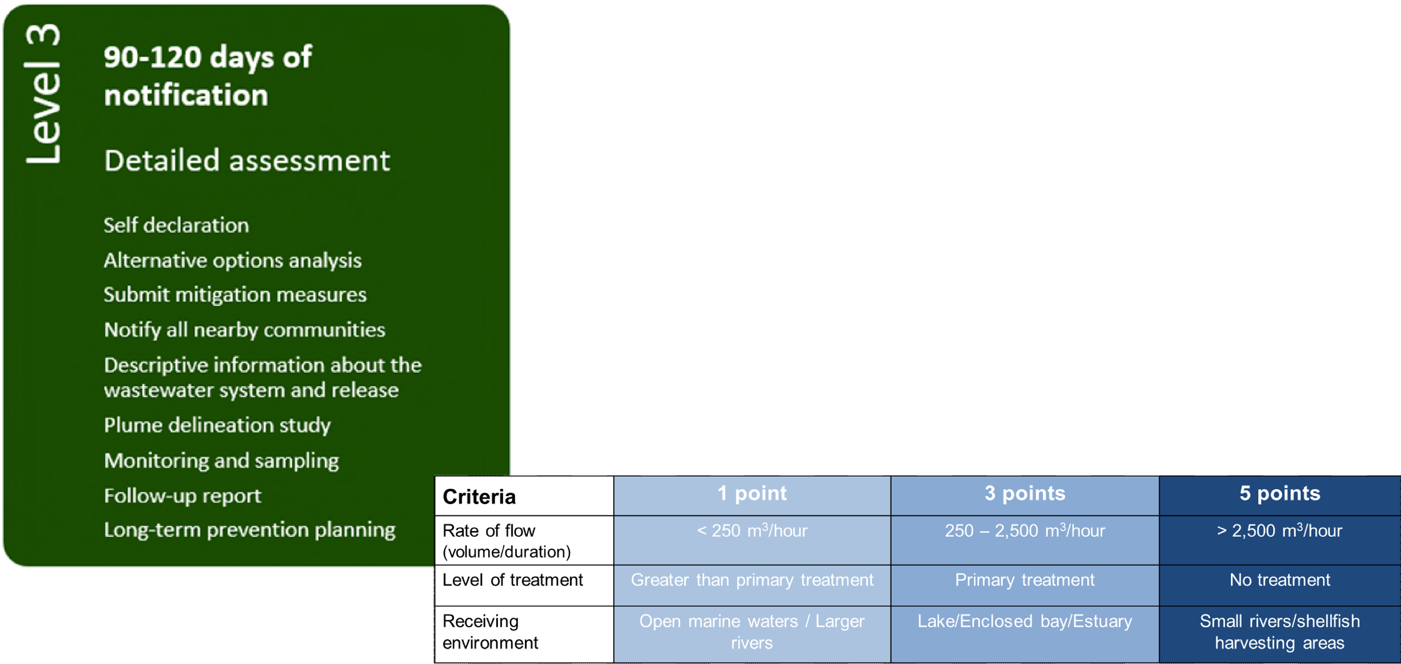
Level 3 (11-15 Points)

Slide 37
Other Proposed Administrative Amendments
ECCC is proposing to address various operational/administrative challenges that have arisen during the course of administering the Regulations
  Requiring notification when a system uses the exemption for suspended solids results between July – Oct as part of their average
ECCC is reviewing provisions to streamline and reduce regulatory burden
  Allowing more flexible methods for monitoring small continuous outfalls
Look for opportunities to harmonize the WSER with other FA regulations
  Outlining the notification requirements for unauthorized deposits

Slide 38
Wastewater Systems Effluent Regulations
AFNWA will be regulated under the Fisheries Act by Environment and Climate Change Canada
National Performance Standards (NPS)
  Total Suspended Solids (TSS): < 25mg/l
  Carbonaceous Biochemical Oxygen Demand (CBOD): < 25mg/l
  Chlorine Residual(where applicable): < 0.02mg/l
  Un-ionized Ammonia, expressed as nitrogen (N) at 15 ⁺ 1ºC: < 1.25mg/l

Slide 39
AFNWA – Wastewater Systems Effluent Regulations Plus
Environmental Risk Assessments (ERA)
Canadian Council of Ministers of the Environment (CCME) Strategy
Dillon contracted to conduct ERAs as part of Asset Management Plans
Determine Environmental Quality Objectives (EQO) based on receiving body analysis
Determine Environmental Discharge Objectives (EDO) based on characteristics of the effluent and “mixing” factors at the outfall
ERAs have identified EDOs above and beyond the NPS for some systems

Slide 40
Wastewater Treatment Facility Classifications
Wastewater Treatment Facility Classifications
Facility Name | Facility Classification | Wastewater Treatment Process | Average Wastewater Flow (Theoretical)
Abegweit | Class I | On-site septic, recirculating textile filter | 1 m3/d
Elsipogtog | Class I | Facultative lagoon | 1392 m3/d
Esgenoopetitj | Class I | Aerated lagoon, sodium hypochlorite | 714 m3/d
Eskasoni | Class II | Sequencing Batch Reactor, UV | 2040 m3/d
Kingsclear | Class I | Aerated lagoon, UV | 383 m3/d
Lennox Island | Class I | Facultative lagoon, UV | 209 m3/d
Paqtnkek | Class II | Sequencing Batch Reactors, sand filter (not operational) | 230 m3/d
Pictou Landing | Class II | Rotating Biological Contactor, UV | 265 m3/d
Potlotek | Class I | Aerated lagoon, UV | 321 m3/d
Sipekne'katik-Indian Brook | Class I | Aerated lagoon, sand filter, UV | 720 m3/d
Tobique | Class I | Aerated lagoon | 842 m3/d
Wagmatcook-Lagoon System | Class I | Aerated lagoon, sodium hypochlorite | Unknown
Wagmatcook-RBC System | Class II | Rotating Biological Contactor, UV | Unknown
40

Slide 41
Wastewater Sampling Program
By community invitation, AFNWA will begin sampling in communities ahead of December 1, 2022
In some communities, samples have not been taken for compliance with WSER
Working with Operators to participate in sampling with samples delivered to an accredited laboratory for testing
AFNWA has released an RFP to secure laboratory analytical services

Slide 42

Wela’lin!
Woliwon!
Carl Yates (782) 414-6628
carl.yates@afnwa.ca
www.afnwa.ca

