Slide 1

AFNWA Updates; the journey continues
October 12, 2022
Carl Yates, interim CEO

Slide 2
Mission
To provide safe, clean drinking water and wastewater in all participating First Nations communities in Atlantic Canada, delivered by a regional water authority owned and operated by First Nations.

Slide 3
Vision
To be a recognized leader for the delivery of water and wastewater services to First Nations communities across Canada.

Slide 4
Values – Seven Grandfather Teachings
Love (Kitpu/Cihpolakon - Eagle)
Honesty (Putup/Putep - Whale)
Humility (Paqtism/Malsom - Wolf)
Respect (Tiam/Mus - Moose)
Truth (Mikjikj/Cihkonaqc - Turtle)
Bravery (Muin/Muwin - Bear)
Wisdom (Kopit/Qapit - Beaver)

Slide 5
The Recent Roadmap
AFNWA and ISC signed Framework Agreement on June 23, 2020
AFNWA Board approved the Transition Implementation Plan [TIP] on June 24, 2020 to serve as a road map to track activities and milestones to make ready for autonomous operation in Spring 2022.
The Ten Year Business Plan, Service Delivery Transfer Agreement, Community Agreement and Federal Funding commitments are key milestones of the TIP
With the completion of the 2021/22 fiscal year, we are positioned to achieve our objectives
A new TIP was developed and approved to reflect 2022/2023 objectives
The objectives are centred on increased level of service, sustainable funding, public health outcomes and environmental stewardship in the context of self determination and capacity building for First Nations

Slide 6
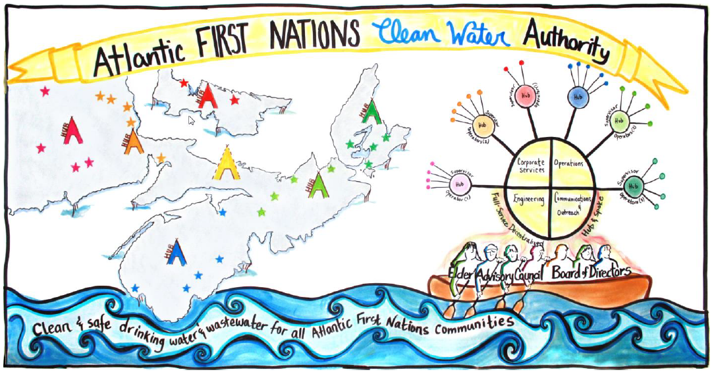
Service approach that is accountable, equitable and based on Two-Eyed Seeing

Slide 7
Participating Communities
New Brunswick
  Elsipogtog
  Esgenoôpetitj
  Kingsclear
  Oromocto [MTSA]
  St. Marys [MTSA]
  Tobique
Prince Edward Island
  Abegweit
  Lennox Island
Nova Scotia
  Acadia [MTSA]
  Eskasoni
  Glooscap [MTSA]
  Membertou [MTSA]
  Millbrook [MTSA]
  Paqtnkek
  Pictou Landing
  Potlotek
  Sipekne’katik
  Wagmatcook in 2022
  We’koqma’q in 2022

Slide 8
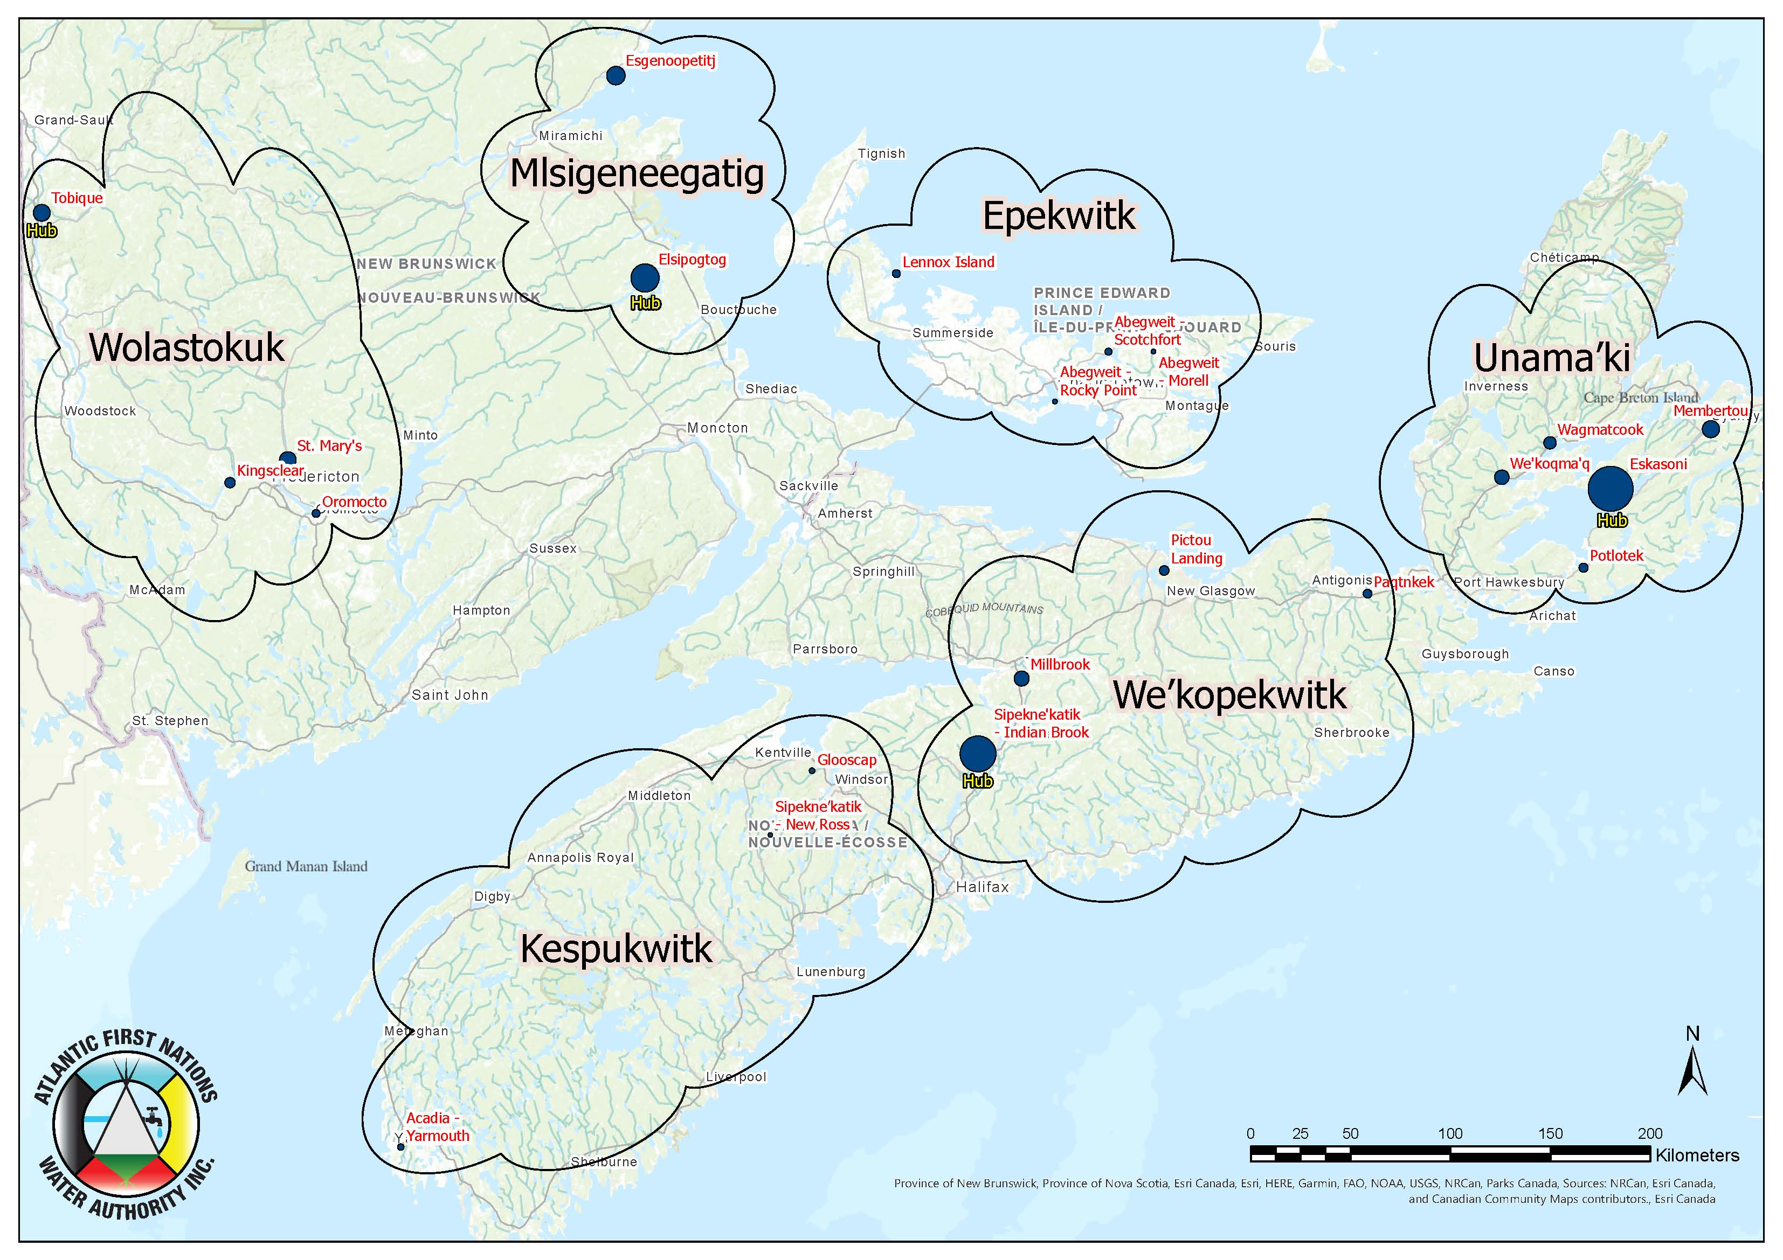

Slide 9
Recap – Business Readiness
Governance in Place [Board of Directors and Elders Advisory Lodge active] with Governance Manual, By-Laws and Enterprise Risk Management Framework established
Ten Year Business Plan approved
Treasury Board approval of $257 million in funding over ten years
Water and Wastewater Quality Oversight Framework in place
Economic Oversight Framework being developed with First Nations Financial Management Board
Management and back office staff in place [25 employees]
Community Operators are engaged [Quarterly Workshops held since fall 2020]

Slide 10
Oversight Framework
Drinking water quality based on NS Environment & Climate Change framework.
  Compliance with Guidelines for Canadian Drinking Water Quality
  Proactive measures developed with the adoption of water and wastewater safety plans [Nujo’tme’k Samqwan]
Wastewater to conform to Wastewater System Effluent Regulations [WSER] with oversight from Environment and Climate Change Canada [ECCC]
Relationship with First Nations Financial Management Board to develop framework for economic oversight [MOU approved by Board on January 26, 2022]
  Economic oversight to demonstrate financial stewardship for Canada and Communities served by AFNWA
  Goal to achieve certification from FNFMB for not-for-profit organizations to leverage debt servicing through First Nations Finance Authority

Slide 11
Proposed Drinking Water and
Wastewater Oversight Framework
Water and Wastewater Oversight Framework
Internal Standard of Care
Oversight Standards
Oversight Entities
Nujo’tme’k Samqwan - risk management practices
Monitoring, treatment, reporting requirements, inspections, and upgrades
Public Health and Environmental Oversight:
Drinking water (interim): ISC (FNIHB&RO)
Wastewater:
ECCC
Contracted Risk Management Auditor
Technical Reviewer (Unit within NSECC)
Environmental Public Health Officers/PHE/PHP
Environmental Inspection Officers
Notes:
Integrated the two boxes

Slide 12
Economic Oversight Framework

Slide 13
Funding Overview - First Nations Water and Wastewater Service
AFNWA Approach:
  Ignored the historical and revised ISC methodologies
  Took a long term view for both capital and operating [ten year budget]
  Capital Budget based on recent work completed by Dillon Consulting, Eramosa Engineering and AFNWA Management review
  Operating Budget compiled from first principles with a zero-based budget approach [supported by information from participating communities, AFNWA Management and best practice review]
  Full funding from the federal government
  No user fees for water and wastewater service

Slide 14
Ten Year Capital Budget
*
**
**
*
**
**
* Capital Programs were identified through an internal Capital budgeting exercise.
** Capital Projects were identified by Dillon Engineering and Eramosa Engineering through their Asset Management Plan and SCADA Review.
Notes:
Capital Programs include: Tools & Equipment, vehicles, consulting studies (hydraulic, reservoir inspection, lagoon depth), IRP, HQ

Slide 15
Ten Year Operating Budget

Slide 16
Recap - The Agreements
Service Delivery Transfer Agreement (SDTA)
  AFNWA and Canada [Ready to Execute]
Funding Agreement
  AFNWA and Canada [Ready to Execute]
Access Permits (Indian Act)
  AFNWA, Canada and Member Communities [Final Draft]
Access Permits (Custom Land Code)
  AFNWA and Member Communities [Final Draft]
Community Agreement
  AFNWA and Member Communities [Final Draft]

Slide 17
Community Onboarding a Phased Approach
There are four phases:
  Early Adopters (December 1, 2022)
  Patient Adopters (April 1, 2023)
  Late Adopters (2023/2024 Fiscal Year)
  Future Adopters [with the standard membership protocol]
In order to complete the transaction, AFNWA will require:
  Council BCRs
    Inclusive of Land Access Permits and O&M funding redirection
    Community Agreement Approval

Slide 18
AFNWA Board Direction
Service Delivery Transfer Agreement and Funding Agreement come into full force and effect when 8 communities become members of AFNWA
Management directed to get 10 communities as members by December 1, 2022 and 14 communities by April 1, 2023

Slide 19
How to join AFNWA as Employee
Community Operators will be offered employment on the same date as Community transfers system responsibility
Expect some Operators will show interest for Supervisor jobs
Promote careers with AFNWA for First Nations
  On the job-training and education support
  Promote education through scholarships
  Preference to hire First Nations candidates

Slide 20
Total Compensation
Salaries and Wages
  Base Pay tied to National Public Sector Market using Korn Ferry methodology
  Market survey every three years
  Annual adjustments in between survey years based on Canadian CPI [3.4% for 2021]
  Eligible employees receive overtime pay at 1.5 times base pay and double time on holidays [cash or banked time]
Pensions and Benefits
  Defined Contribution Pension Plan [50/50 Cost sharing]
  Contributions at 5.6% of Salary up to CRA Yearly Maximum Pensionable Earnings [YMPE]
  Contributions at 7.6% above YMPE [currently $64,900]
  All employees participate in Canadian Pension Plan
  Medical and Dental Plans tailored to employee needs [50/50 Cost sharing]

Slide 21
Total Compensation
Vacation
  3 weeks to start and up to 6 weeks after 20 years of service
  Existing Operators community service recognized for vacation
  Coverage for Operators when they go on vacation
Sick Benefits
  Accumulated at 1 and ¼ days per month [15 days per year]
  Sick Leave accruals up to 90 working days
  Coverage for Operators when they call in sick
Career Development Support
  Courses tailored to job
  Support for continuing education

Slide 22
Vacation Benefits
Three weeks up to Ten years of service
Four weeks after Ten years of service
Five weeks after Fifteen years of service
Six weeks after Twenty Years of service
Current service with First Nation Community will be used for calculation of vacation as an employee of AFNWA

Slide 23
Operator Salaries-Skill Based Pay
The salary range for an Operator is $46,247 to $57,808 depending on level of certification. There are eight steps in the range starting at Operator in Training with increments after each subsequent certification
The maximum salary is $57,808 for an Operator with Level 2 certification in all four categories

Slide 24
Supervisor/Lead Operator
There will be a Supervisor/Lead Operator assigned to each Service Area
The Operations Supervisor salary will range from $51,565 to $64,455
There are eight steps in the range with a maximum pay of $64,455 when Level 2 certification is obtained in all four categories
Supervisor will be assigned company vehicle for response in service area [mobile office]

Slide 25
Medical/Personal Leave Benefits
Paid medical leave credits for employees at the rate of 1-1/4 days per month for each month employed up to a maximum of 15 days per fiscal year
Medical leave credits can be carried over from year to year to a maximum of 90 working days
An employee is entitled to a maximum of five days of paid leave per year for personal reasons
AFNWA will participate in Provincial Workers Compensation Programs
There are many other Leave Benefits under the HR Policy [Maternity/Paternity, Bereavement, Education, etc.] – Please refer to the Policy for specific benefits

Slide 26
Training and Career Development
With Covid travel restrictions being lifted, more opportunities for in person training through ACWWA, MPWWA
On-line courses are still an option
AFNWA will also coordinate training session based on need
AFNWA will pay for courses, study guides, tutoring, etc. to obtain Operator certification or other work-related courses
We will adopt a formal training and development program for all AFNWA staff.

Slide 27
Onboarding Employees
As part of the onboarding check list, we are looking for the most up to date information on Operators:
  Years of service with First Nation community
  Education
  Level of certification
  Information for Payroll
Operators will be provided laptops and cell phones

Slide 28
Critical Path Next Steps
Oct. to Nov. 2022 Dedicated Outreach to Community Chiefs and Councils to present Business Plan, and Community Agreement to ensure an informed decision to transfer water and wastewater system responsibility and become a member of AFNWA
Sept. to Nov. 2022 Complete Onboarding Checklist with Band staff
Dec. 1, 2022: Begin Operations in Early Adopter Member Communities

Slide 29

Wela’lin!
Woliwon!
Carl Yates (782) 414-6628
carl.yates@afnwa.ca
www.afnwa.ca

